Slide 1

UNIT 1: INTRODUCTION TO PYTHON
Python Fundamentals & Architecture
Exploring Software Systems and Programming Paradigms
Presented By:
Dr. Anup Girdhar
CEO-Sedulity Solutions & Technologies
Email: anup@sedultygroups.com

Slide 2
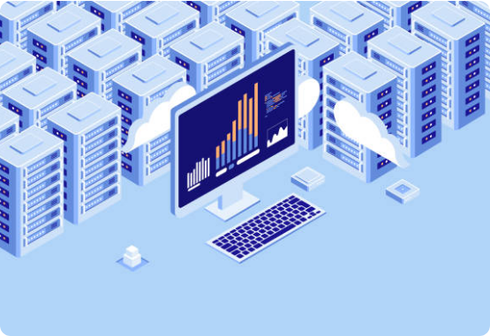
1.1 Introduction to Programming
Programming is the strategic design of instructions that empower computers to solve complex problems.
Bridge between human logic and hardware.
Foundation for AI, Web, and Cyber Security.
Python: The world’s leading language for readability.

Slide 3
Software Development Architecture
Understanding the structural blueprints that define how applications, servers, and databases communicate and scale.

Slide 4



Single Tier Architecture
The simplest architecture where all components—User Interface, Business Logic, and Database—reside on a single system.
Key Attributes:
Low complexity and zero network latency.
Ideal for standalone desktop applications (e.g., MS Word).
Standalone System
Limitation: Not scalable for multi-user environments.

Slide 5



Two Tier Architecture
Commonly known as Client-Server Architecture. Communication occurs directly between the client and the server.
Client Tier: Handles UI and some logic.
Server Tier: Manages data and heavy logic.
Common in early database applications and internal tools.

Slide 6




Three Tier Architecture
The standard for modern web applications. It introduces a dedicated Application Layer to decouple logic from data.

Slide 7
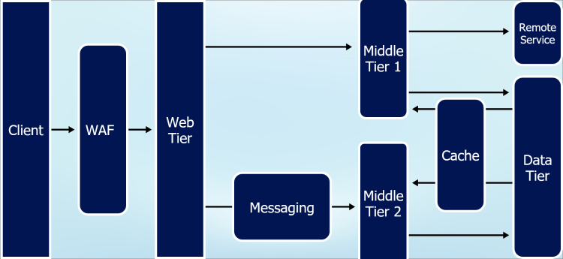
Multi-Tier (N-Tier) Architecture
Used for massive enterprise systems. It breaks the application into numerous sub-tiers for Security, Caching, and Scalability.
Includes Firewalls and Proxies.
Caching layers (Redis) for speed.
Microservices approach.

Slide 8
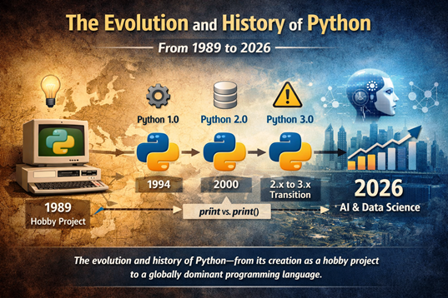

Evolution of Python
Created by Guido van Rossum in 1989. Released 1991.
Python 2.0 (2000): Memory management features.
Python 3.0 (2008): Modern syntax overhaul.
Python 3.12 (Latest): Performance optimizations.

Slide 9


Why Python is the Preferred Choice
Simplicity
Portable
Libraries
English-like syntax allows developers to focus on logic rather than boilerplate code.
Runs on Windows, macOS, and Linux without modification. Truly platform-independent.
From NumPy to TensorFlow, it provides pre-built tools for every scientific domain.

Slide 10


1.7 Interpreter vs Compiler
Interpreter (Python)
Compiler (C++/Java)
Translates code line-by-line.
Translates whole program at once.
Immediate execution and easier debugging.
Creates an executable file (.exe).
Slower runtime performance.
Faster execution after compilation.
Python uses both: Source → Bytecode → PVM (Output)

Slide 11
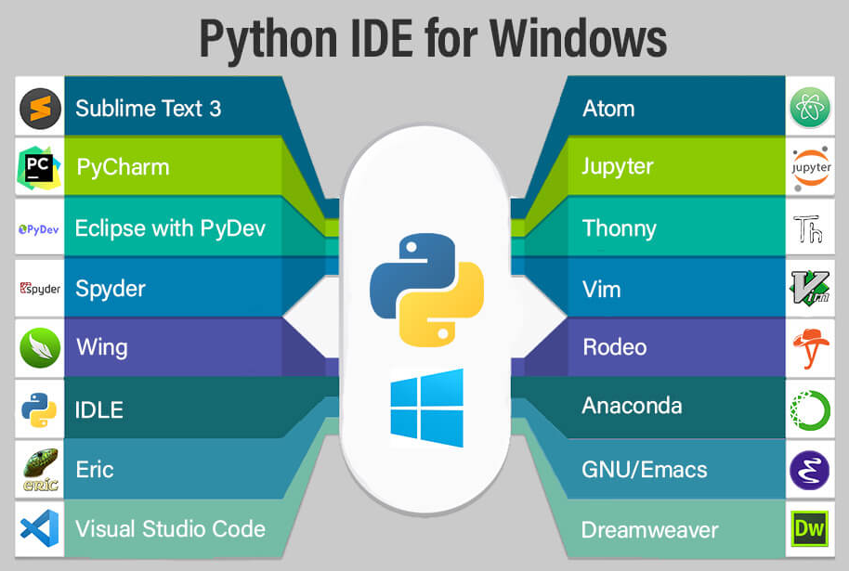
Setting Up the Workspace
Modern development requires an IDE (Integrated Development Environment) for efficiency.
VS Code: Lightweight, massive extensions.
PyCharm: Professional enterprise features.
Jupyter: Interactive data visualization.

Slide 12
Questions?
Presented By:
Dr. Anup Girdhar
CEO-Sedulity Solutions & Technologies
Email: anup@sedultygroups.com

Slide 13

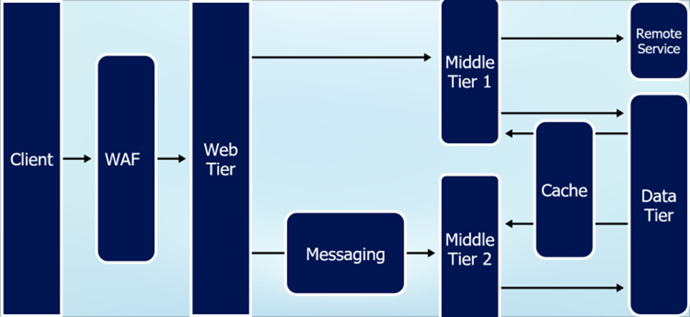
Image Sources
https://media.istockphoto.com/id/2166701872/vector/big-data-computer-and-server-park.jpg?s=612x612&w=0&k=20&c=tqLGIIlGPU1Ls6WOwxHcOPKRi5svZVcKR44YTqBd6R0=
Source: www.istockphoto.com
https://share.google/TChYoMneAt4X5oxBn
Source: netmaxims.com
https://share.google/Q6Ck5hG8zwWqSTt9B
Source: pycoderhub.com
https://www.educba.com/python-ide-for-windows/
Source: educba.com

